Slide 1

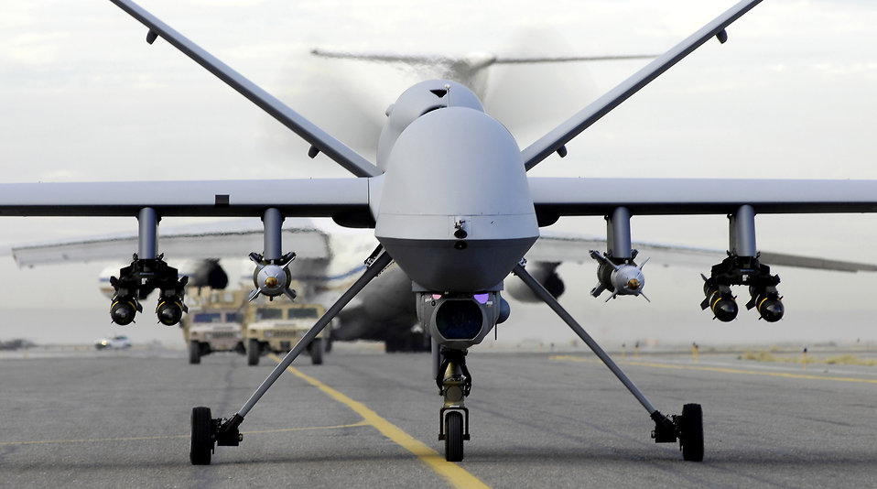
UAV's (Unmanned Aerial Vehicles)
Presented By :
Haider Abbas Moazzam
Momin Shahzad Butt
(22L-7862,22L-7959)

Slide 2
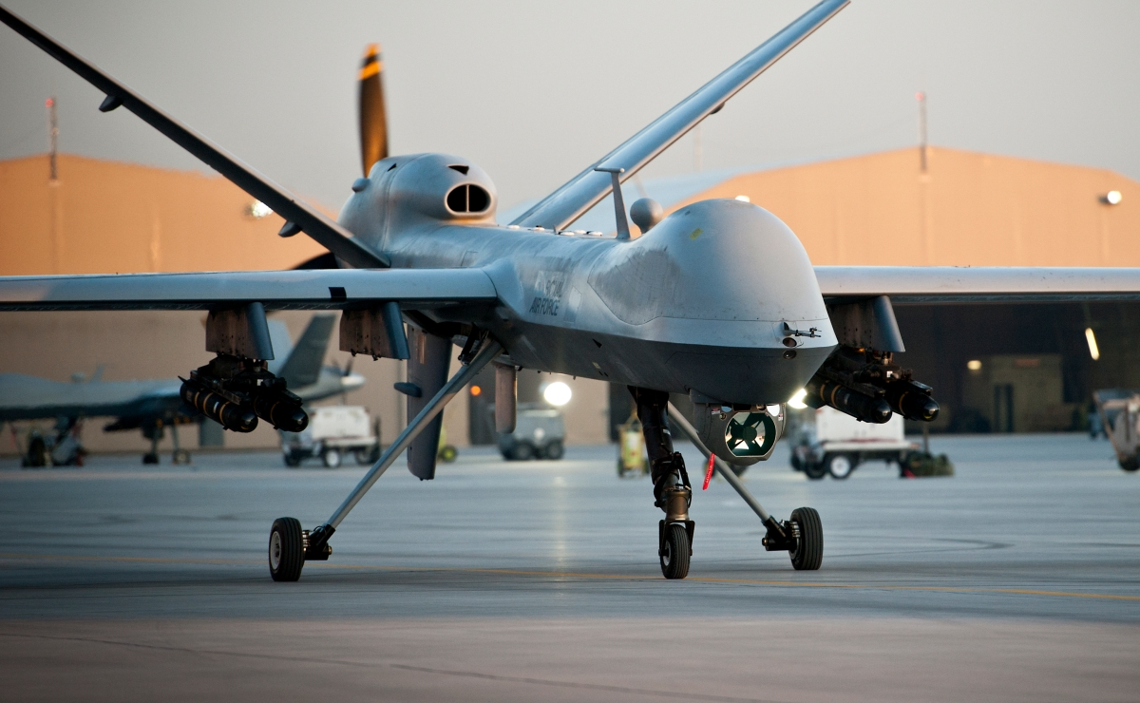
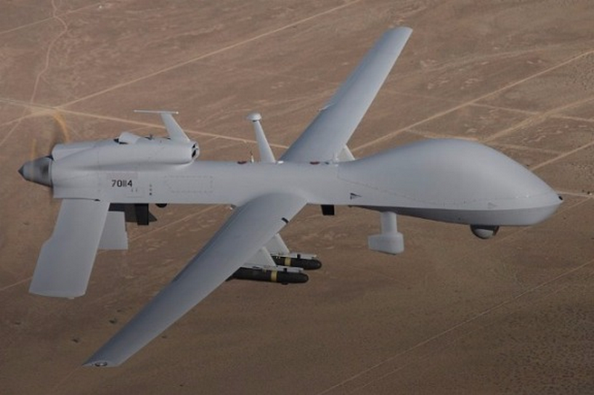
Introduction
• An unmanned aerial vehicle (UAV) is an aircraft without a human pilot on board.
• Controlled either by an in-built computer or remote.
• Commonly Known as a drone.
• Has other names like RPV, RCV, ACV.

Slide 3
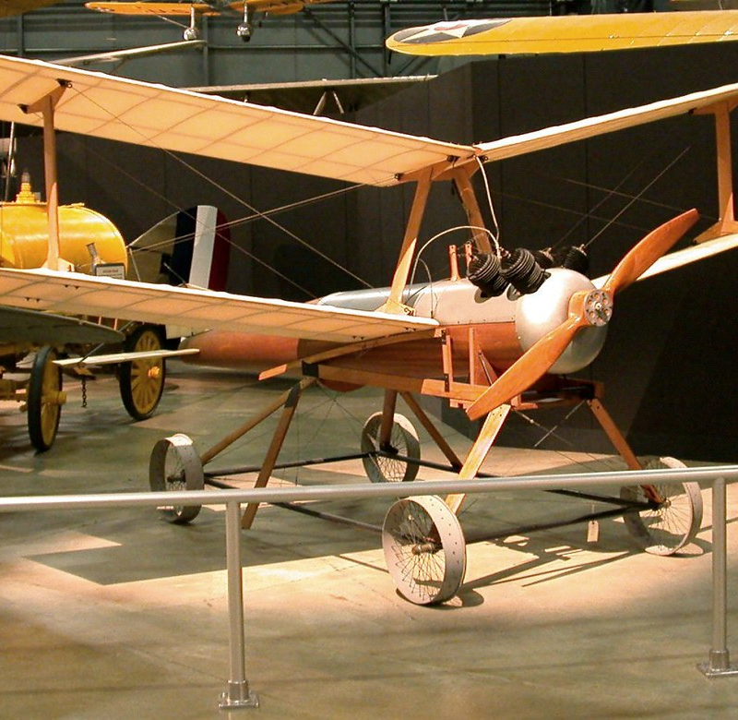
History
• Austrian Air Balloons in 1849
• A.M.Low's pilotless aircraft against the zeppelins (WW1)
• Hewitt Sperry Automatic Airplane (aerial torpedo)
• Kettering Bug in 1918

Slide 4
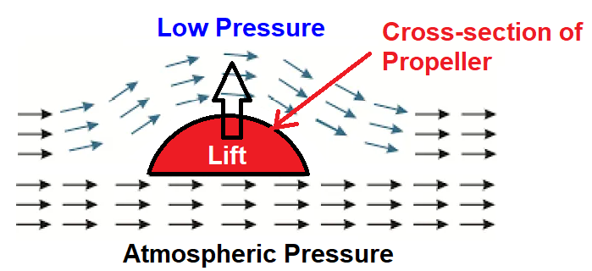
Working
The subject of Fluid dynamics plays a significant role in the design and development of aircraft and drones.
A sufficient amount of upward force is required to lift the vehicle against gravity which is named Lift.
A force created to move the vehicle or body in motion is called thrust.

Slide 5
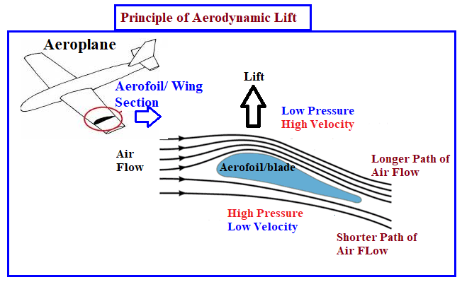

Slide 6
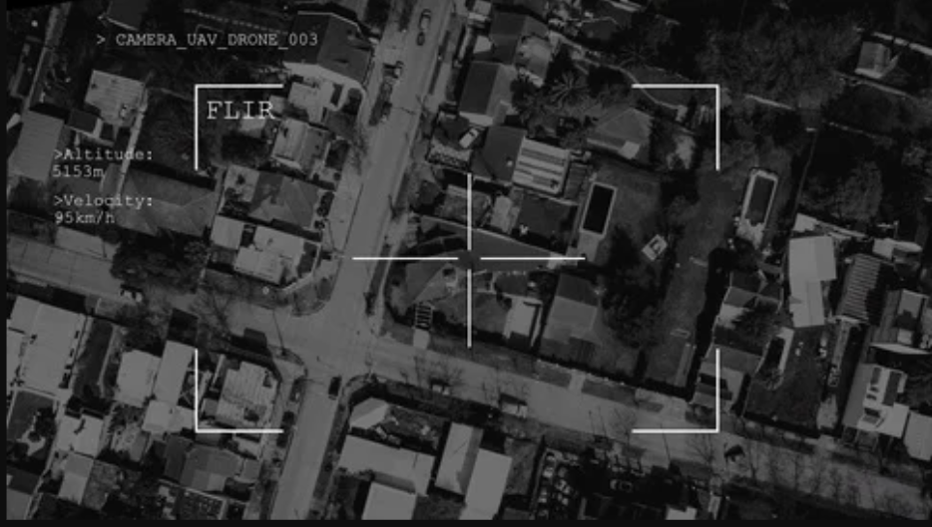
Technological Features
GPS modules
Ultrasonic sensors and collision avoidance sensors
Accelerometer (for measuring speed)
Altimeter, which measures altitude
High performance Cameras
Artificial Intelligence (AI) that follows objects.
Obstacle Sensory Range

Slide 7
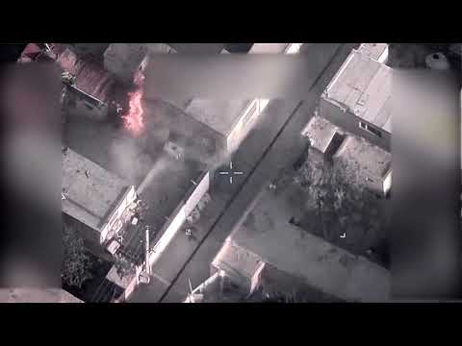
Use In Military
• Used in Reconnaissance
• Used in combat and combat support
• Used in military logistics
• Used for Command and Control

Slide 8
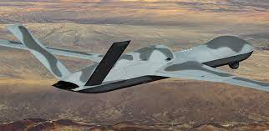
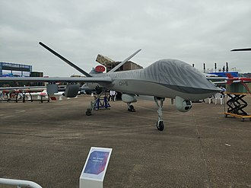
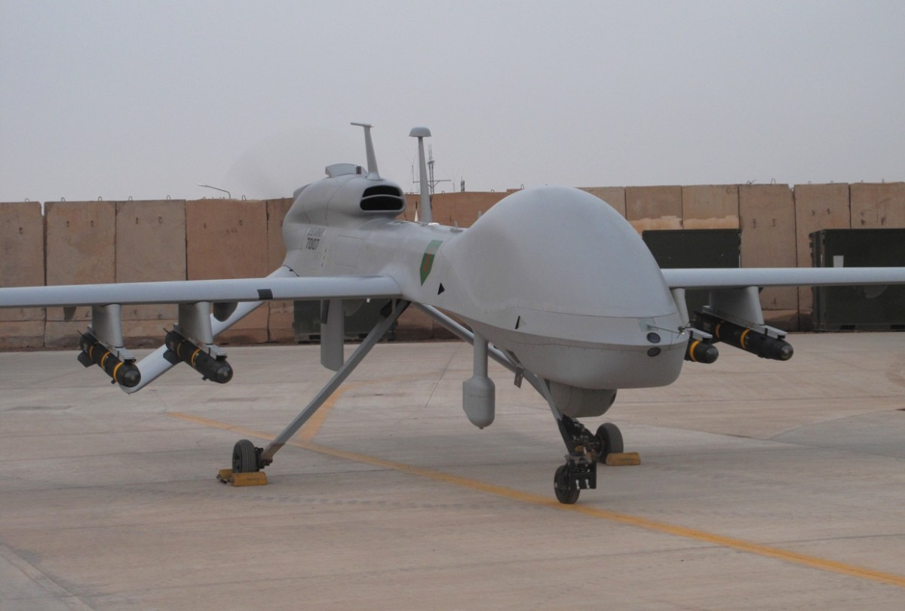
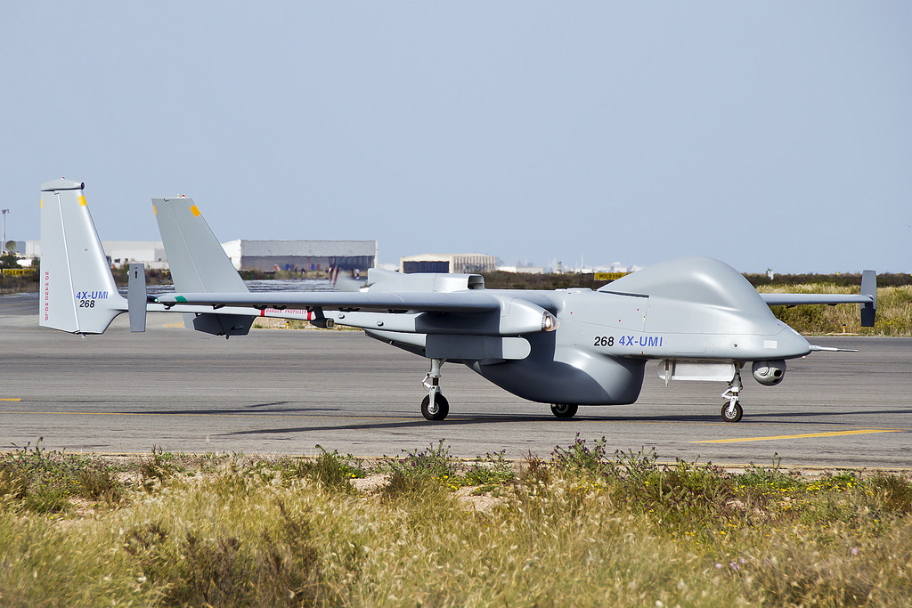
Top Military Drones in the world
Predator C Avenger CH-5
MQ-1C Gray Eagle Heron TP

Slide 9

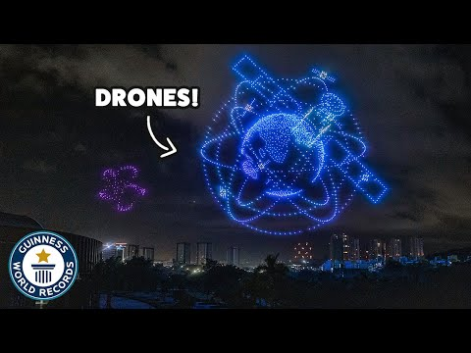
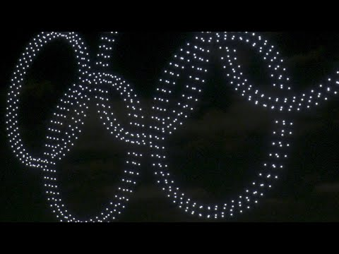
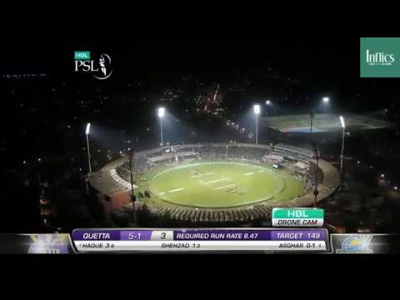
Commercial uses
• Traffic monitoring
• Weather monitoring
• Drone based photography
• Videography
• Agriculture
• Civil Engineering Projects
• Delivery services

Slide 10
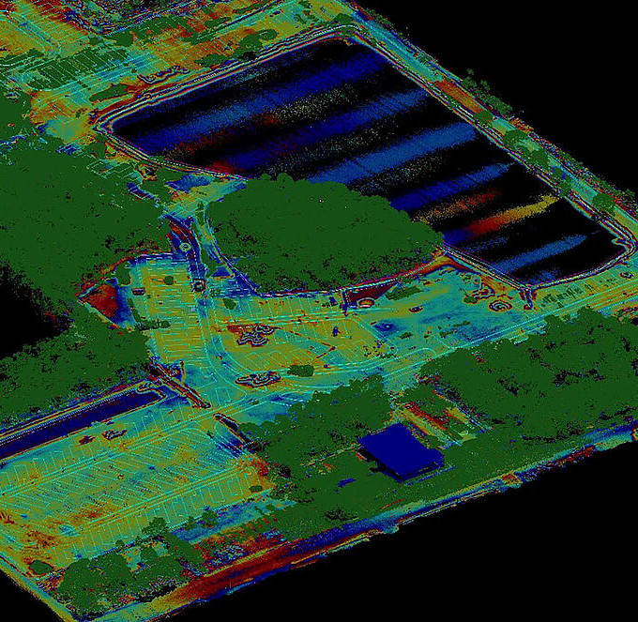
Case Study: Drones in Construction
• Cougar Companies, headquartered in southwest Florida, uses the Microdrones mdLiDAR1000 to deliver detailed topographic surveys.
• One of the aims of the project is to allow comparison of pre and post-construction conditions on the site.
• The client wants to know, for example, how much earth has been moved from one spot to another, and how much work remains to be done.
• After data collection through drones the footage is transferred onto a software which identifies the machinery and landmarks.

Slide 11
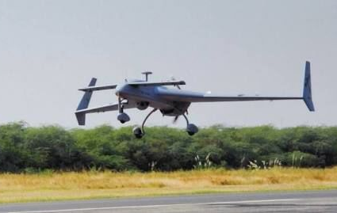
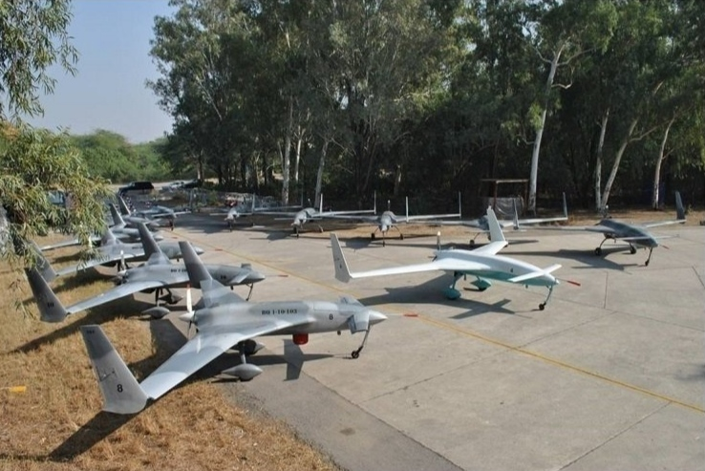
Future of UAVs in Pakistan
• Pakistan's Air Force Burraq (UCAV) developed by NESCOM back in 2009 used primarily in reconnaissance.
• Shahpar-2 (GIDS) developed in 2020, capable of flying over 25000 ft, and used in air to air and air to ground strikes.

Slide 12
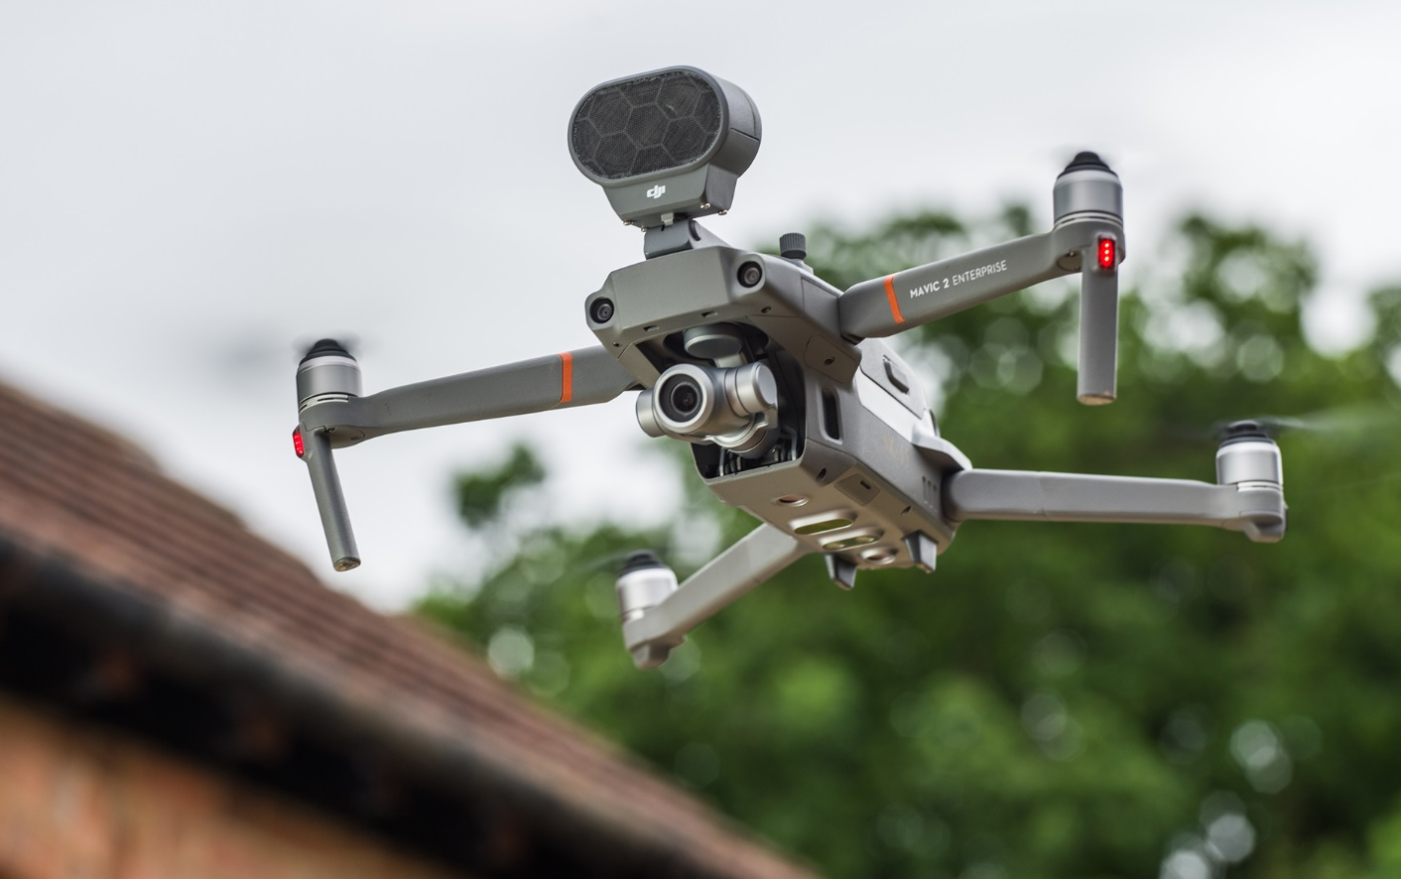
• Youtubers like Irfan Junejo, WildLens by Abrar and UKHANO use drone footages for cinematography.
• Inclusion of drones in PSL for videography.
• DJI's online store.

Slide 13
Conclusion
• The UAV industry is buzzing throughout the world.
• Drones are being used for different purposes in various commercial sectors.
• The supply of drones is directly related to its demand.

Slide 14
Thanks for Listening.
Any Questions?

